Slide 1
IEC TC 34 Panels to be held in Milan hosted by the Italian National Committee - CEI
14 – 25 January 2013

Slide 2
Meeting schedule
 | MONDAY 14 |  | TUESDAY 15 |  | WEDNESDAY 16 |  | THURSDAY 17 |  | FRIDAY 18
 | 1st room | 2nd room | 1st room | 2nd room | 1st room | 2nd room | 1st room | 2nd room | 1st room | 2nd room
am | Component Reliability (50) Room n. 5 |  | LED Panel (50) Room n. 5 |  | LED Panel (50) Room n. 5 |  | LED Luminaire Perf. (50) Room n. 5 |  | LED Retrofit (20) Room n. 9
pm |  |  |  |  |  |  | LED T&D (50) Room n.5
 | MONDAY 21 |  |  | TUESDAY 22 |  |  | WEDNESDAY 23 |  |  | THURSDAY 24 |  | FRIDAY 25
 | 1st room | 2nd room | 3rd room | 1st room | 2nd room | 3rd room | 1st room | 2nd room | 3rd room | 1st room | 2nd room | 1st room | 2nd room
am | LUMEX IP (20) Room n. 5 | DALI (20) Room n. 9 | IEC 60968 CFLi Safety (15) Room n. 4 | LUMEX PAP (20) Room n.5 | DALI (20) Room n.9 | IEC 60969 CFLi Perf. (15) Room n. 4 | LUMEX PAP (20) Room n.5 | COMEX Safety software (20) Room n.9 | CFLi Perf. tiers (15) Room n. 4 | COMEX CG (20) Room n. 5 | PRESCO HID perf. (20) Room n. 9 | COMEX PT HID perf. (20) Room n. 9
pm | LUMEX ELP (20) Room n. 5 |  |  |  |  |  |  |  | IEC 60901 CFL non-i dimming (15) Room n. 4 |  |  | TC34 IC (20) Room n.9

Slide 3
Meeting Venue
CEI
Comitato Elettrotecnico Italiano
Via Saccardo, 9
20134 Milano - Italy
tel +39 0221006.1
For further information on the meeting venue, please visit the website at www.ceiweb.it

Slide 4
How to reach CEI
From Malpensa Airport: “Malpensa Express” train to Cadorna North railway station (times: from 5:00 to 23:00 every 30 minutes - running time: about 40 minutes) or “Malpensa Shuttle” bus to Milano Centrale railway station. From both railway stations underground line n°2 (green) headed Gessate, Cascina Gobba or Cologno Nord, get off at Lambrate FS stop. (http://www.milanomalpensa1.eu/en/accessibility-and-parking/means-of-transport/arriving-by-train)
From Linate Airport: taxi or airport bus to Milano Centrale railway station every 30 minutes (http://www.autostradale.it/pdf/ORARIO_STARFLY_AL_PUBBLICO_010909.pdf)
From Orio al Serio Airport: “Autostradale” bus (timetable and information: www.autostradale.it) to Milano Lambrate railway station or to Milano Centrale railway station underground line n°2 (green) headed either Gessate, Gobba e Cologno Nord, Lambrate FS stop.
ARRIVING AT CEI BY CAR: CEI can be easily reached by car to reach CEI by motorway, take the Tangenziale Est (A51) to the Rubattino exit and take the direction Via Saccardo.

Slide 5
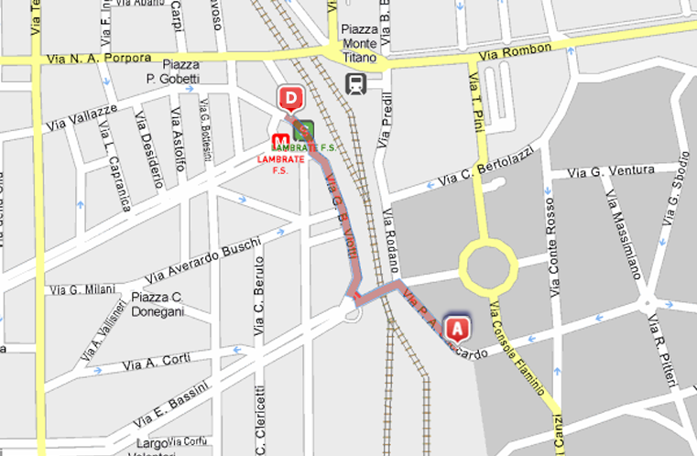
How to reach CEI
(D) From Lambrate FS (underground and railway): CEI can be easily reached by walk (about 10 minutes) following the red line on the map below.

Slide 6
Milan Metro map

Slide 7
How to book the hotels
For reservation, each participant is requested to book directly to the hotel as indicated in the following pages.
Bookings shall be made within 30th November 2012.
After that date the pre-booked rooms will not be guaranteed.

Slide 8
Hotels
HOTEL ECHO (****1st Cat)
Viale Andrea Doria 4 - 20124 MILANO
Tel. +39 02 6789
e-mail: reservations.echo.mi@starhotels.it
The hotel is located exactly opposite the Central Railway Station, few minutes from the city centre by underground. To reach CEI we suggest to take underground line 2 (green) at Centrale FS (direction Cologno, Gobba or Gessate) and get off at Lambrate FS. From here the meeting point can be reached by walk for 10 minutes (see map enclosed).
For reservation, each participant is requested to fill and send the attached reservation form directly to the hotel.
HOTEL RITZ (****)
Via Spallanzani 40 – 20129 Milano
Tel. +39 02 2055
email: ritz.mi@starhotels.it
The Starhotels Ritz is close to Corso Buenos Aires and a few minutes from the Metro station Lima (MM1 – Red Line). To reach CEI from subway station Lima (MM1 – Red Line), choose direction Sesto FS and after one stop, change at Loreto; take MM2 – Green Line (direction Cascina Gobba or Cologno Nord or Gessate) and after 2 stops get off at Lambrate FS. From here the meeting point can be reached by walk in 10 minutes (see map enclosed).
For reservation, each participant is requested to fill and send the attached reservation form directly to the hotel.

Slide 9
Hotels
DORIA GRAND HOTEL (****)
Via A. Doria, 22 – 20124 Milano
Tel. +39 02 67 411 411
Email: prenotazioni.doriagrandhotel@adihotels.com
Price of a classic room (double use as single) including breakfast, service and VAT: € 123,00
The hotel is located near the Central Railway Station, few minutes from the city centre by underground. To reach CEI we suggest to take underground line 2 (green) at Caiazzo (direction Cologno, Gobba or Gessate) and get off at Lambrate FS. From here the meeting point can be reached by walk in 10 minutes (see map enclosed).
Reservation: each participant is requested to book directly the hotel indicating “CEI Agreement/Convenzione CEI” in order to obtain the special price.
HOTEL GAMMA (***)
Via Valvassori Peroni 85 - 20133 MILANO
Tel. +39 02 26413152
e-mail: info@hotelgammamilano.it
Price of a single room including breakfast, service and VAT: € 80
Price of a room (double use as single) including breakfast, service and VAT: € 95
Price of a double room including breakfast, service and VAT: € 120
The hotel is located near FS Lambrate Railway Station. From here the meeting point can be reached by walk for 10 minutes (see enclosed map).
For reservation, each participant is requested to book directly the hotel indicating “CEI Agreement/Convenzione CEI” in order to obtain the special price.

Slide 10
Practical information
Weather: January is the coldest month of the year and the temperature normally is around 0°C
Currency: Euro
Socket outlet: Italian socket outlets are compatible with the 2P plug 2,5 A. In some cases Schuko socket outlets are available
Rated voltage and frequency: 230 V - 50 Hz
Internet connection: all meeting rooms are provided with Wi-Fi for free Internet connection

Slide 11
Contacts
If you need further support or have any further questions please do not hesitate to contact us. We will be happy to help you!
Franco Rusnati
Phone: +39 02 97373352
Mobile: +39 331 6586857
Email: rusnati@assil.it
Daniela Zambelli
Phone: +39 02 21006 246
Email: zambelli@ceiweb.it

